Slide 1
Tutorial: Linking, Extending, Exploiting and Enhancing Tabular Data with Wikidata Part 1: Introduction to Wikidata
Daniel Garijo, Pedro Szekely
Information Sciences Institute and Department of Computer Science
@dgarijov, @szeke {dgarijo, pszekely}@isi.edu

Slide 2
Introduction To Wikidata (25-30 min)
Goals of the Wikidata project
The Wikidata data model
Comparison with DBpedia, YAGO and Cyc
Interesting statistics about Wikidata

Slide 3
Goals of the Wikidata Project

Slide 4
Wikidata is a free, collaborative, multilingual, secondary database, collecting structured data to provide support for Wikipedia, Wikimedia Commons, the other wikis of the Wikimedia movement, and to anyone in the world.
https://www.wikidata.org/wiki/Wikidata:Introduction

Slide 5
Free
The data in Wikidata is published under the Creative Commons Public Domain Dedication 1.0.
Collaborative
Data is entered and maintained by Wikidata editors, who decide on the rules of content creation and management. Automated bots also enter data into Wikidata.
Multilingual
Editing, consuming, browsing, and reusing the data is fully multilingual. Data entered in any language is immediately available in all other languages.
A secondary database
Wikidata records not just statements, but also their sources, and connections to other databases.
Collecting structured data
Imposing a high degree of structured organization allows for easy reuse of data by Wikimedia projects and third parties, and enables computers to process and “understand” it.
Support for Wikimedia wikis
Wikidata assists Wikipedia with more easily maintainable information boxes and links to other languages.
Anyone in the world
Anyone can use Wikidata for any number of different ways by using its application programming interface, the SPARQL endpoint and the JSON and RDF dumps.

Slide 6
Why I ❤️ Wikidata

Slide 7
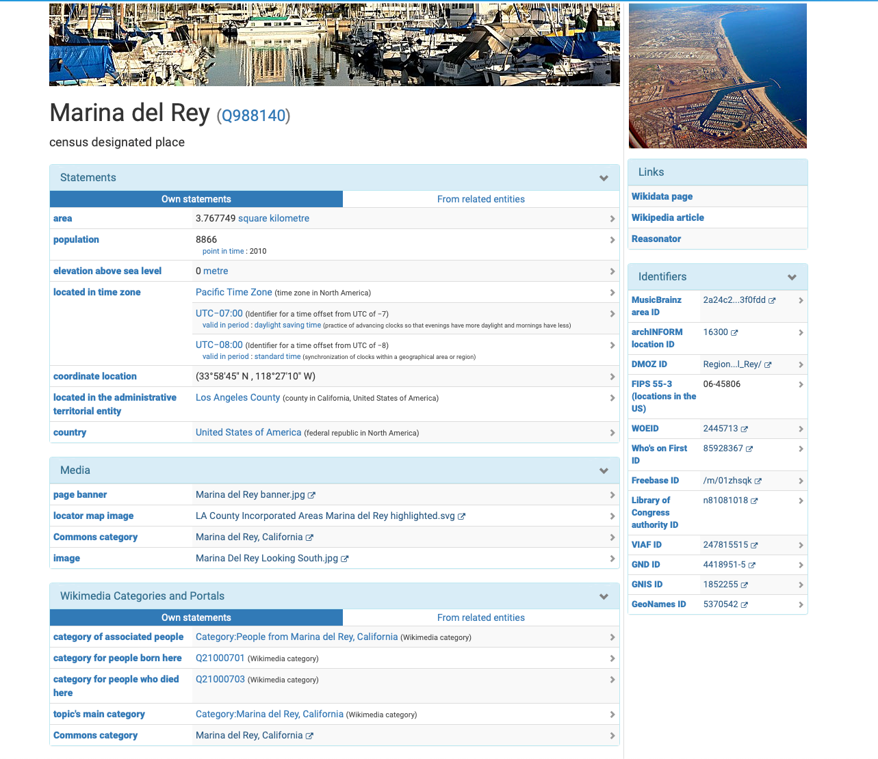

Slide 8
Good data, and lots of it
qualifiers
identifiers

Slide 9
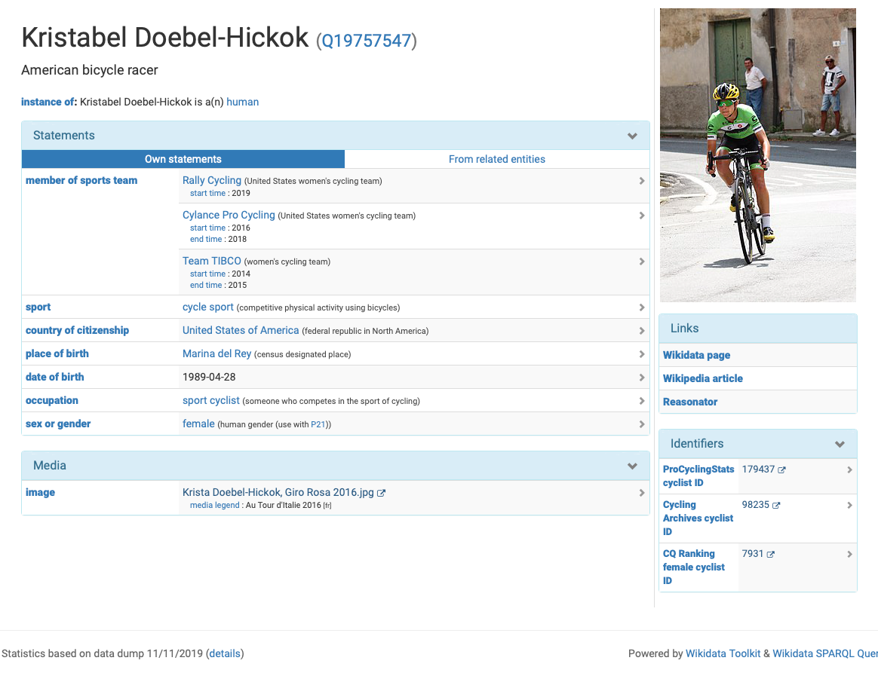

Slide 10
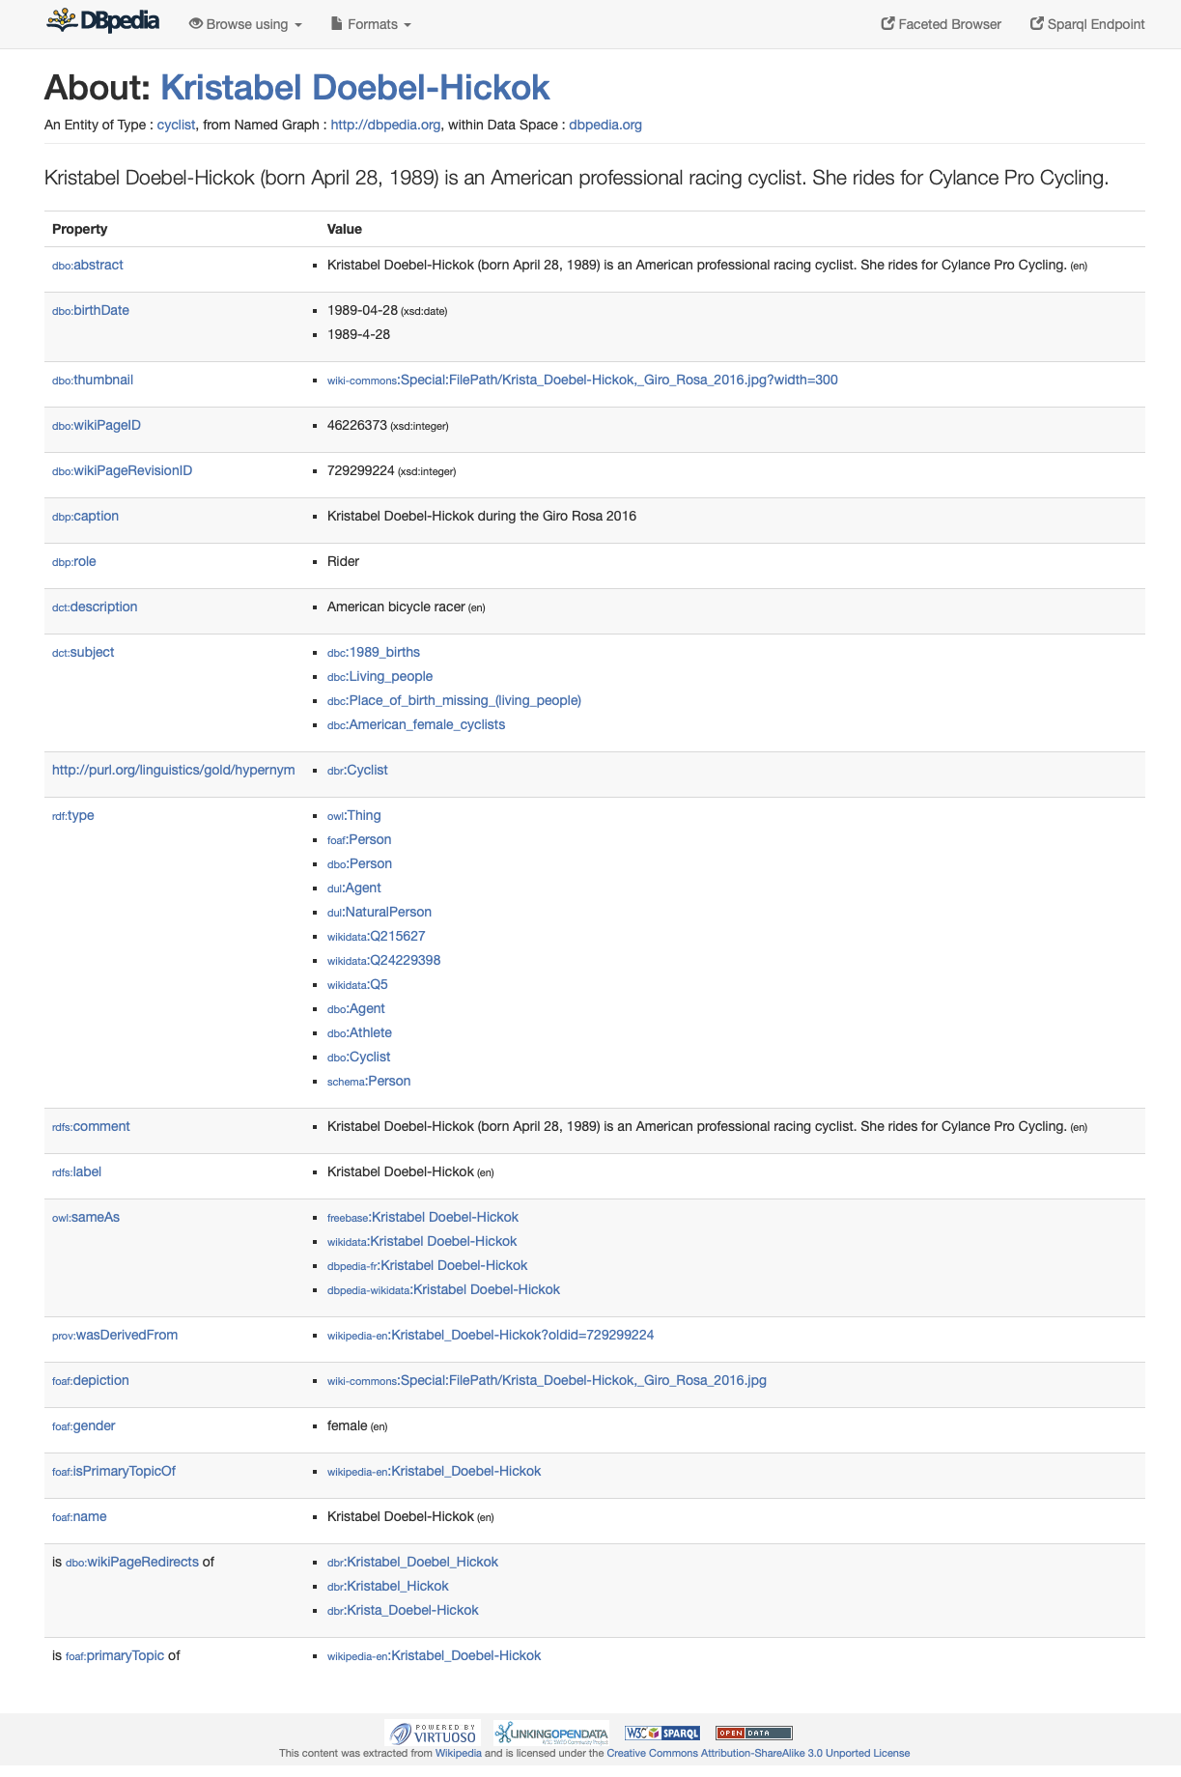
no sports team
no identifiers

Slide 11
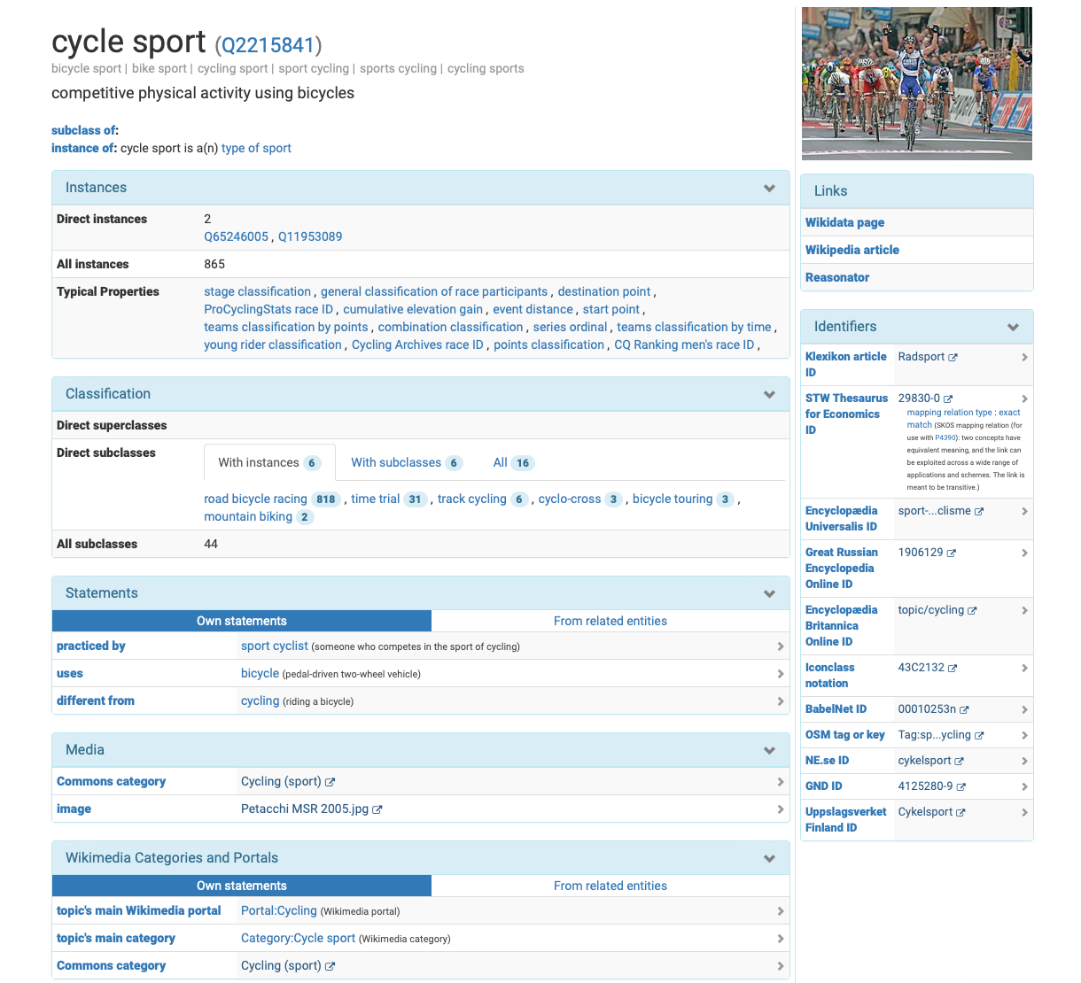
rich ontology
a bit of commonsense knowledge
external identifiers

Slide 12
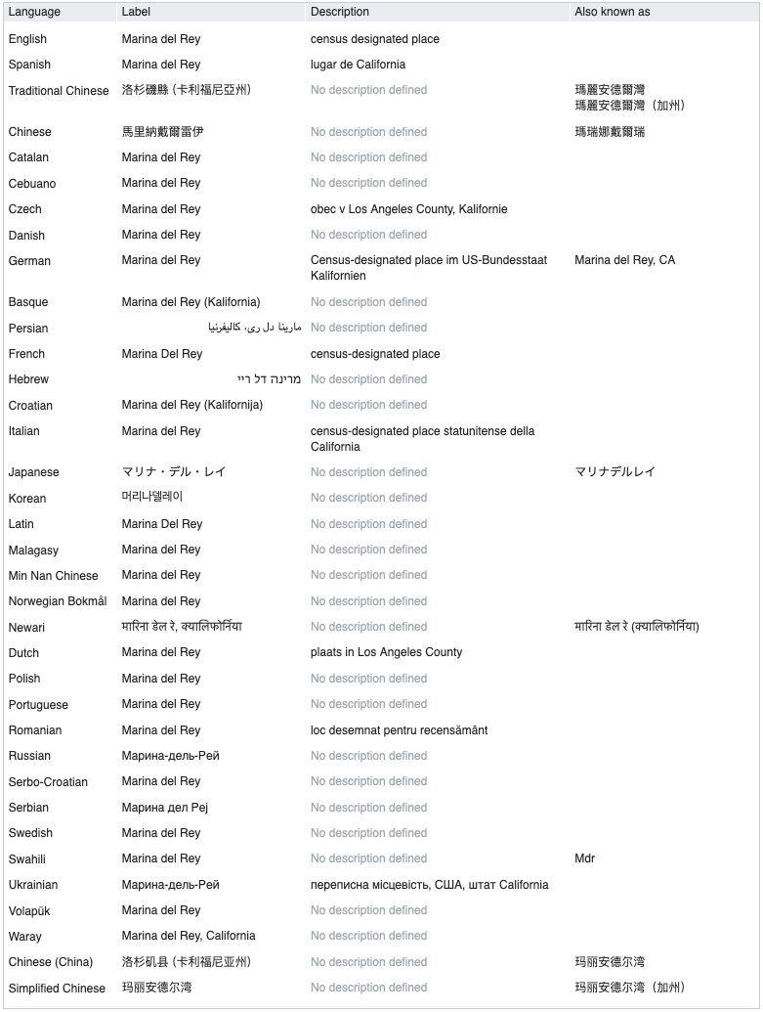
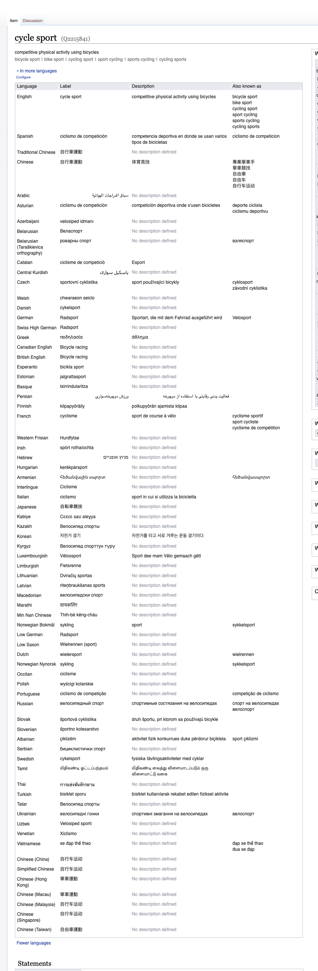
multi-lingual

Slide 13
The Wikidata Data Model

Slide 14
Wikidata Is A Knowledge Graph
values
items
properties

Slide 15
Data Model

Slide 16
Data Model: Identifier (q-node)

Slide 17
Data Model: Multi-Lingual Labels

Slide 18
Data Model: Multi-Lingual Aliases

Slide 19
Data Model: Multi-Lingual Descriptions

Slide 20
Data Model: Statements
statements

Slide 21
Data Model: Triples
subject
property
value

Slide 22
Data Model: Qualifiers
qualifiers: context with additional information
about the triple subject/property/value

Slide 23
Data Model: Qualifiers = property + value
property
value
qualifiers: context with additional information
about the triple subject/property/value

Slide 24
Data Model: Claims
claim
subject + property + value + qualifiers

Slide 25
Data Model: References
references

Slide 26
Data Model: Reference = property+value
property
value
references

Slide 27
Data Model: Statement Rank
rank:
- preferred
- normal
- deprecated

Slide 28
Wikidata Is A Knowledge Graph
values
items
qualifiers
properties

Slide 29
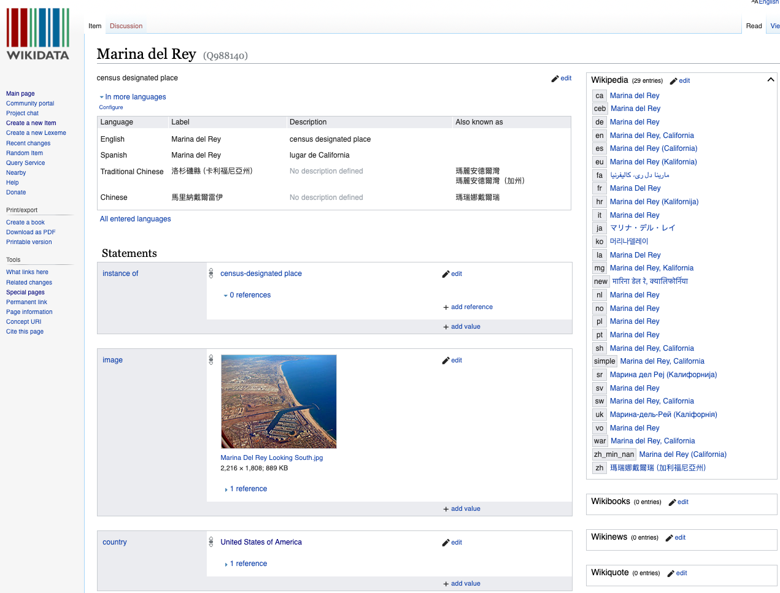
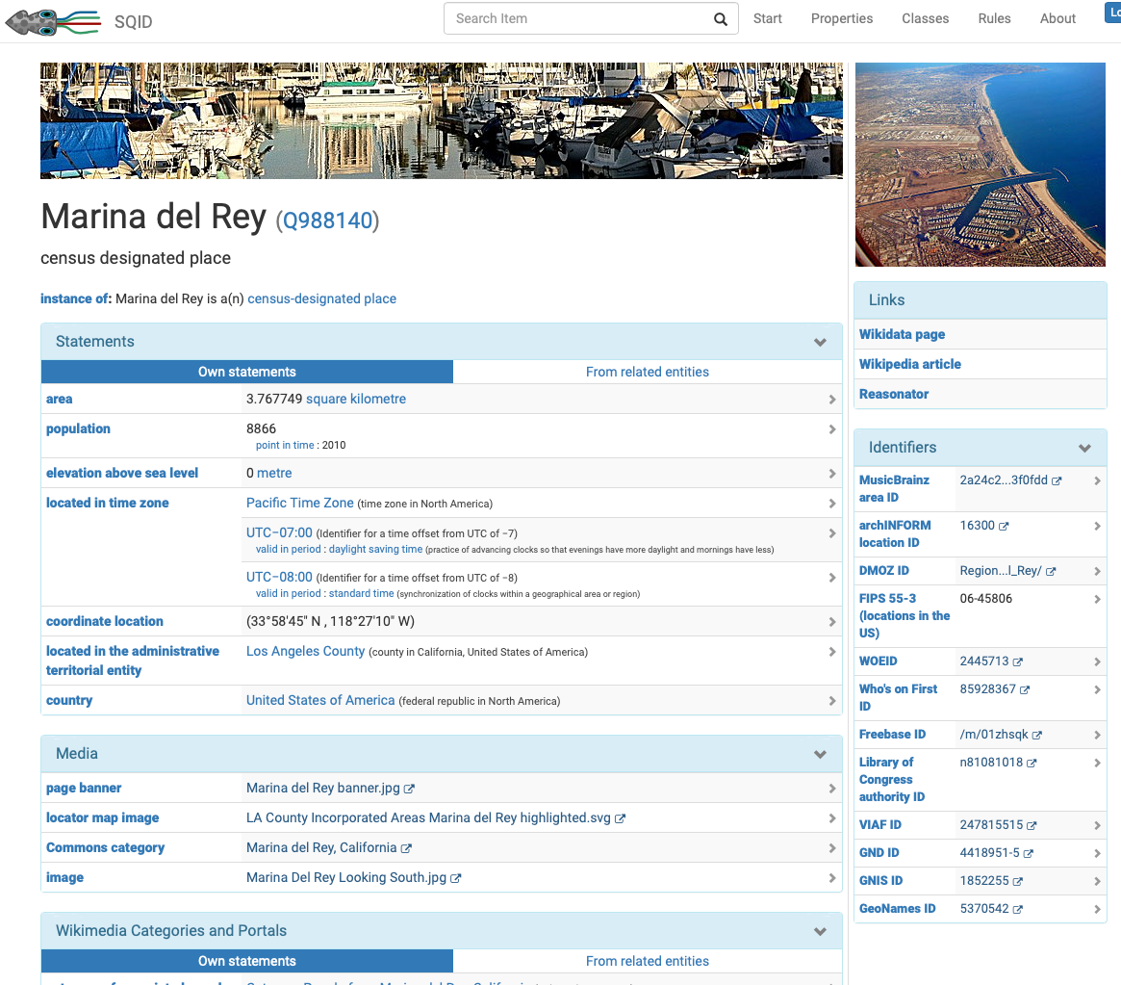
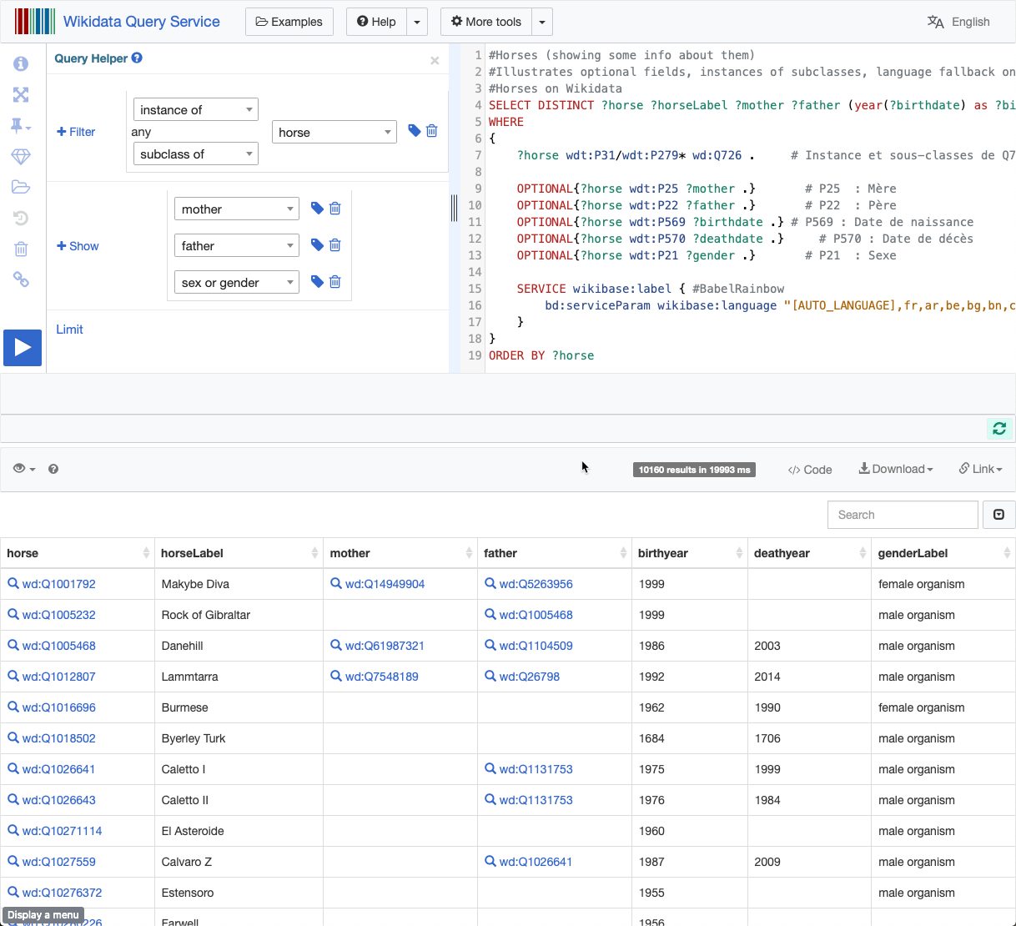
Wikidata Architecture
Browser/Editor
Browser
SPARQL Query
Wikidata
API
Bots
Wikibase
RDF
SPARQL

Slide 30
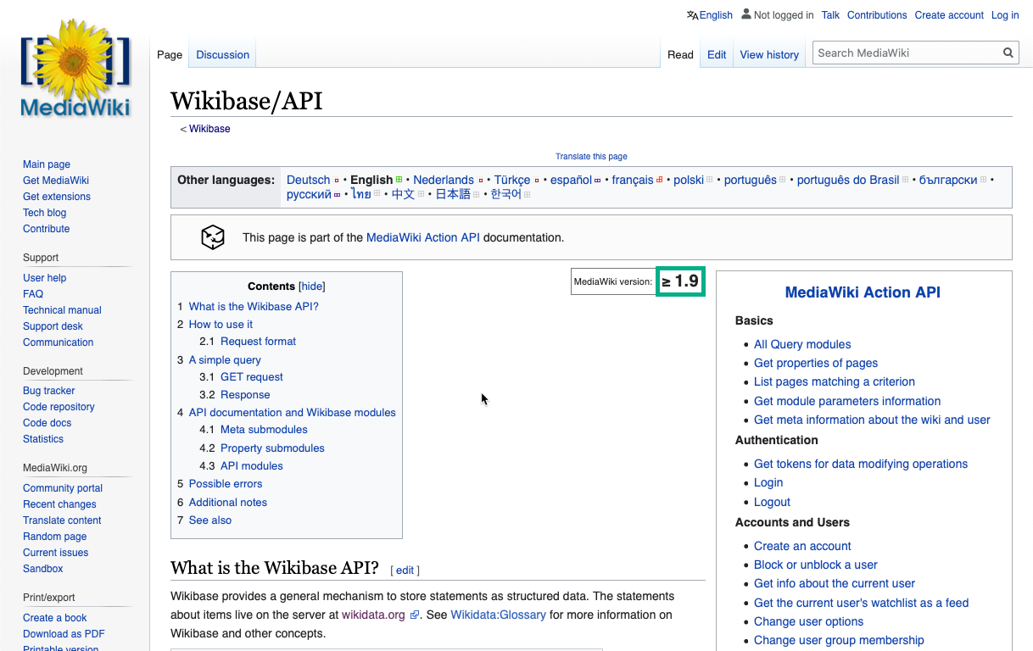
Wikibase API https://www.mediawiki.org/wiki/Wikibase/API

Slide 31
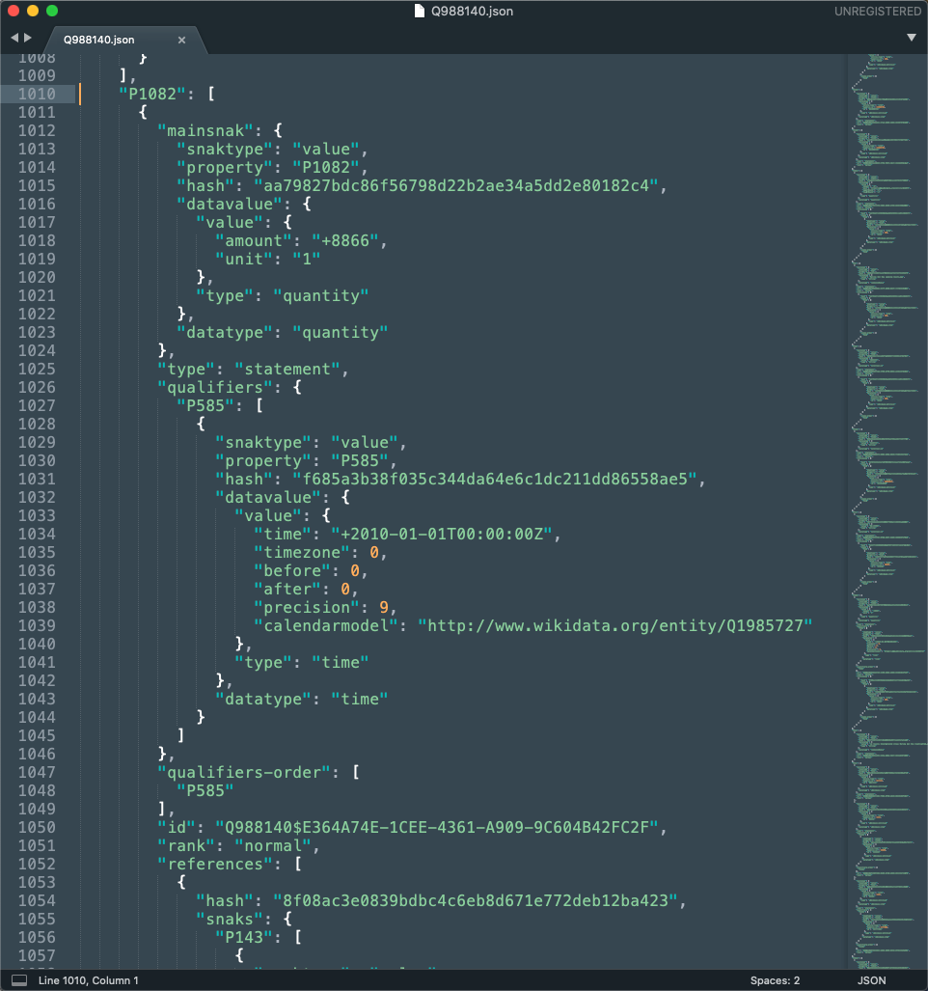
Wikidata JSON Format
items
property
values
qualifiers
references

Slide 32
Comparison With DBpedia, YAGO and Cyc

Slide 33
Wikidata Data Model
Dbpedia and YAGO: RDF Triples
subject + property + value
Wikidata Statements
subject + property + value + qualifiers + references

Slide 34
DBPedia & YAGO: Built From Wikipedia
Bot

Slide 35
Wikidata: Crowdsourced + Bots
Bot
Bot
web

Slide 36
Wikidata Feeds Wikipedia Infoboxes
Bot
Bot
web

Slide 37
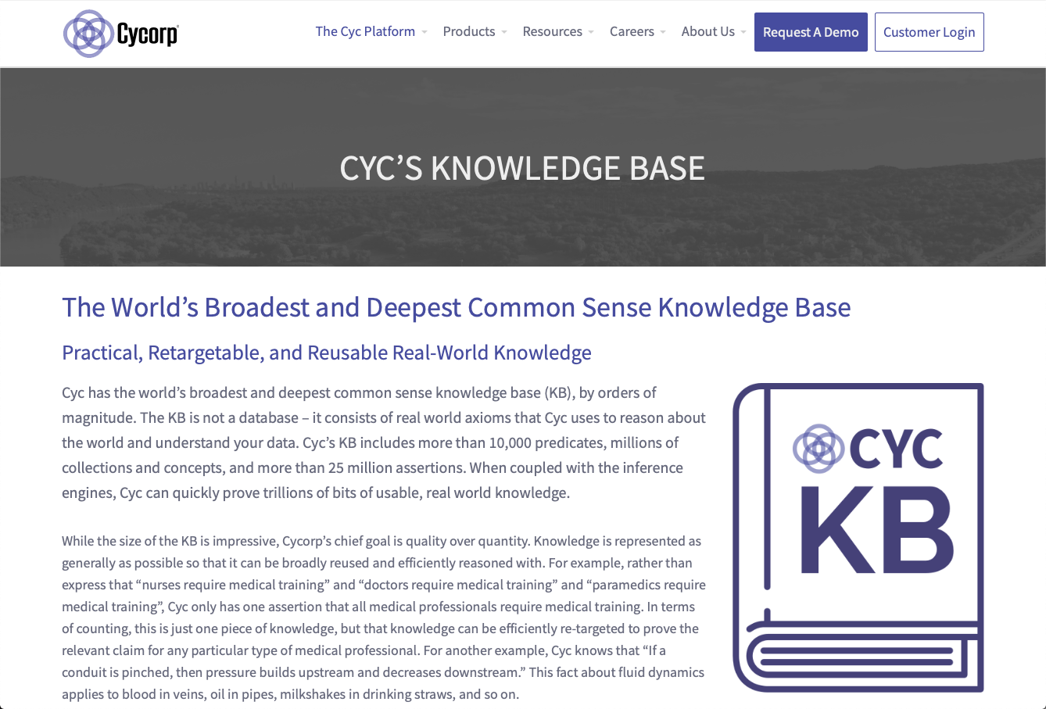
Cyc https://www.cyc.com/
> 10,000 predicates
> 25M assertions

Slide 38
Wikidata “Ontology”

Slide 39
No OWL file
No RDF Schema file
… but there is a very large “Ontology”

Slide 40
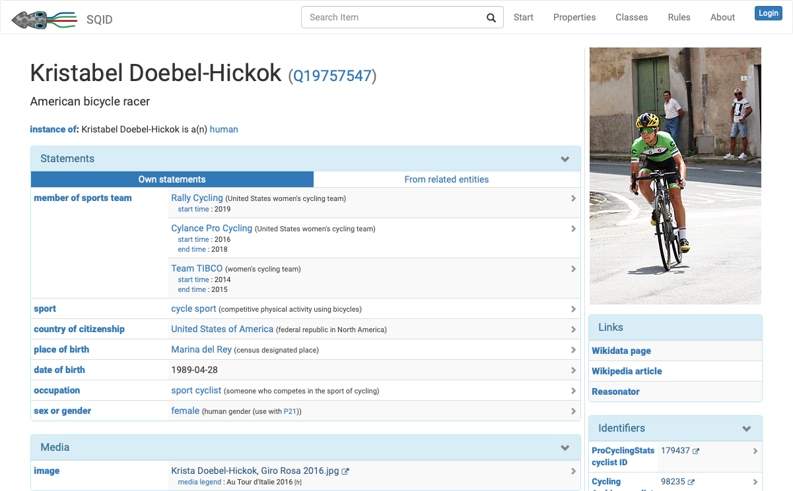
instance of (P31)

Slide 41
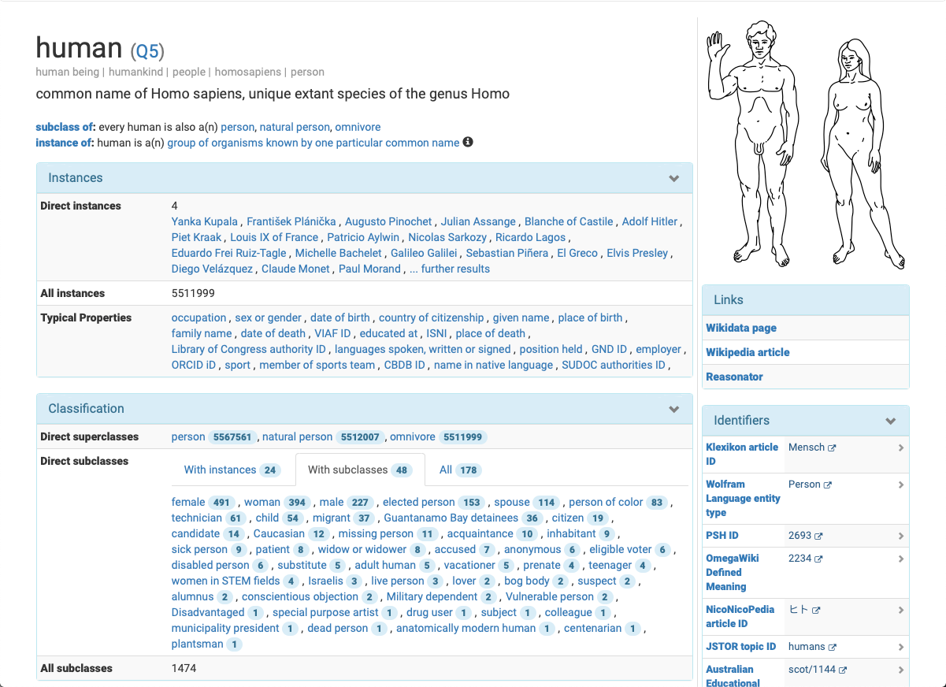
subclass of (P279)

Slide 42
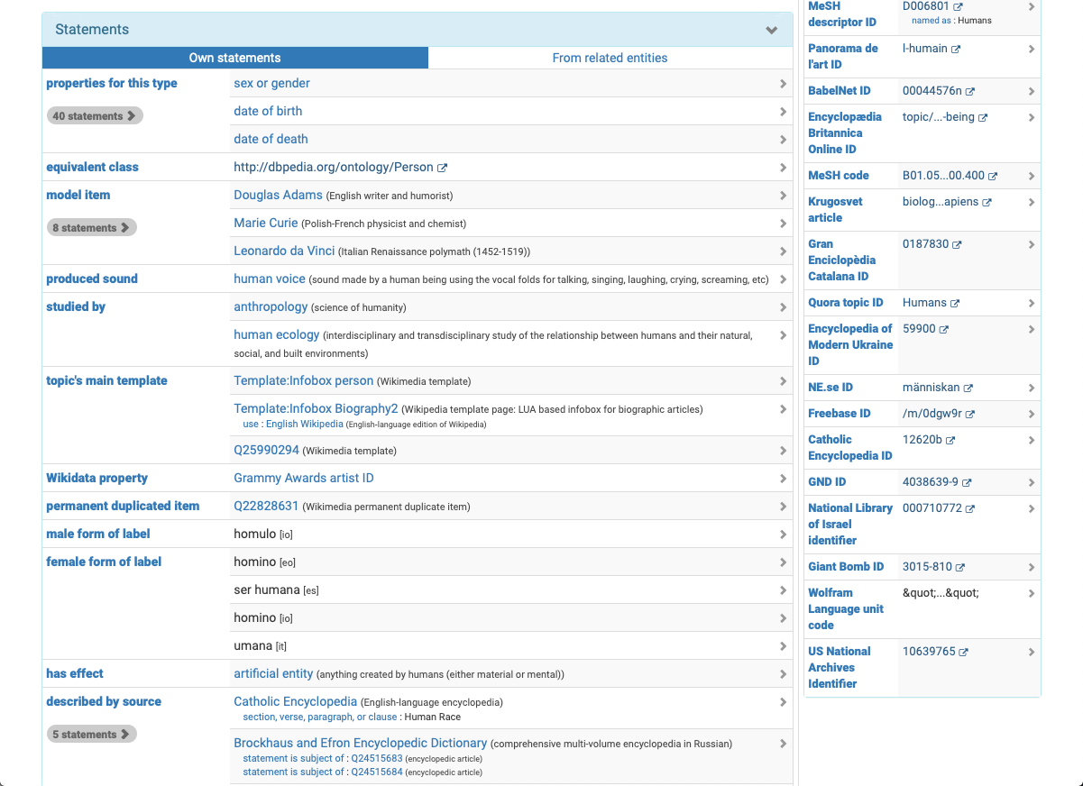
“Classes” Are Items (e.g., Human)

Slide 43
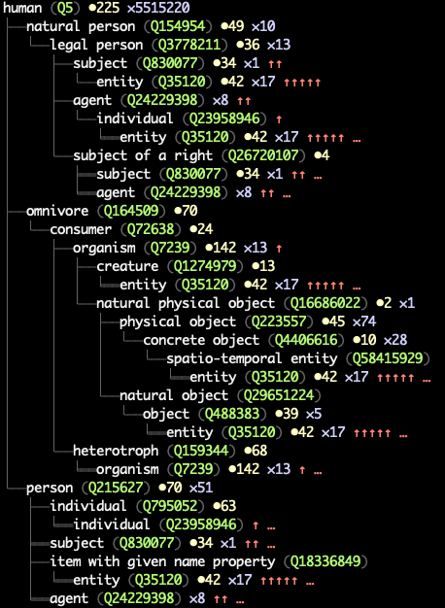
Large Class Hierarchy
2,464,270 classes:
items with a subclass of (P279) property
63,672 classes with instances:
appear as values of instance of (P31) property

Slide 44
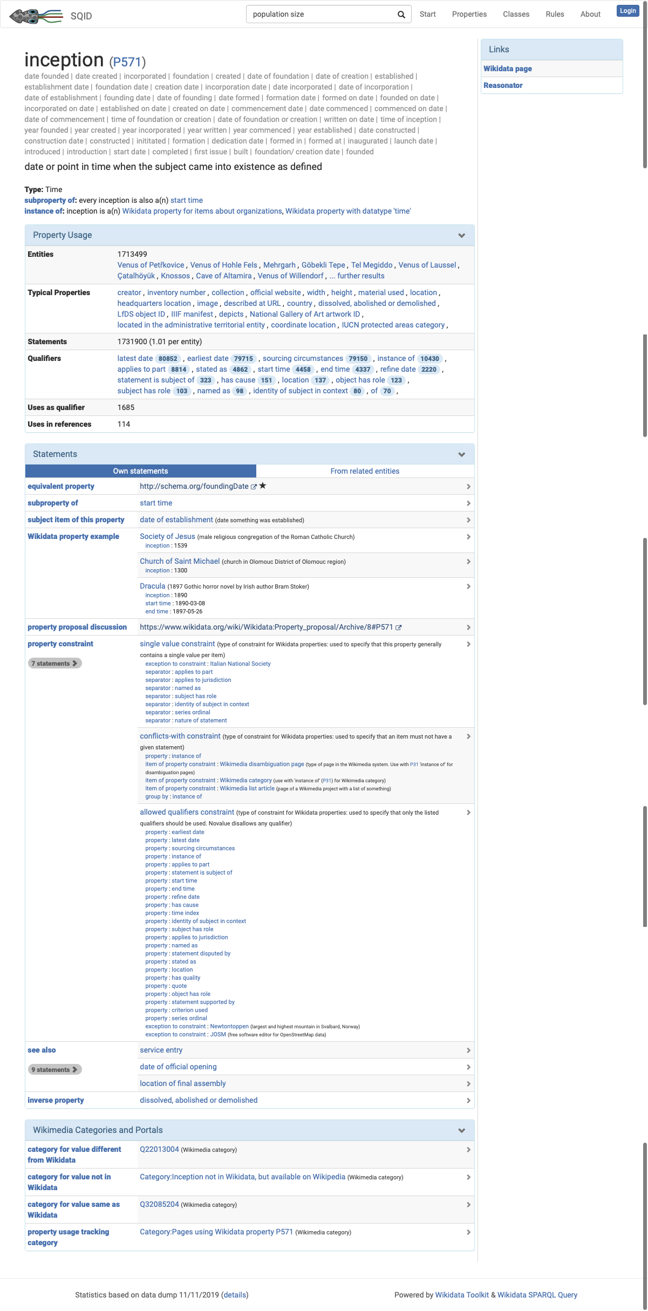
Properties

Slide 45
data type
hierarchy
“domain”

Slide 46
discussion
constraints
inverse

Slide 47
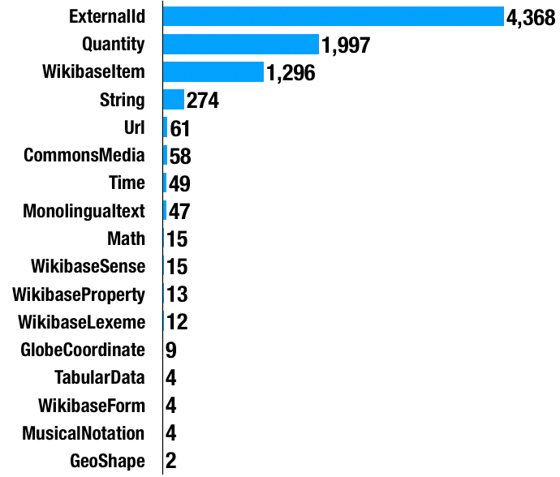
Properties By Type (Total 8,228*)
* in our Wikidata instance (6,884 in the public Wikidata)

Slide 48
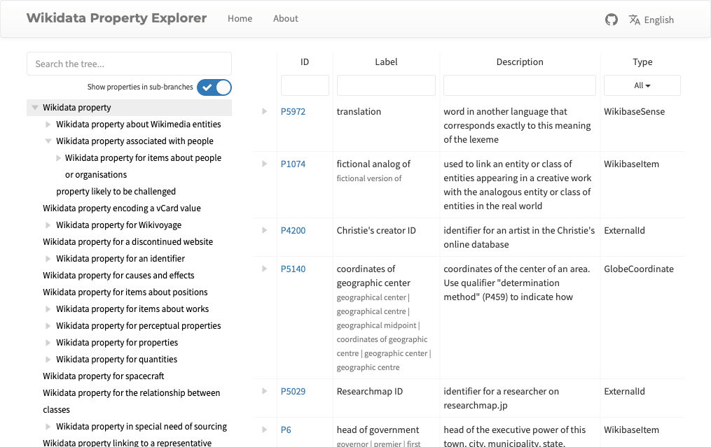
Property Explorer https://tools.wmflabs.org/prop-explorer/

Slide 49
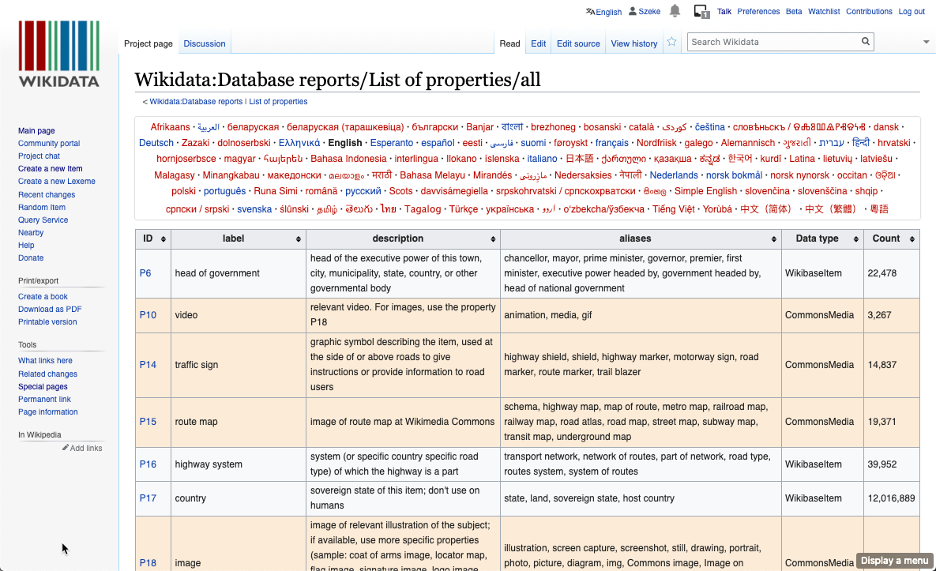
List Of Properties https://www.wikidata.org/wiki/Wikidata:Database_reports/List_of_properties/all

Slide 50
Wikidata Data Modeling

Slide 51
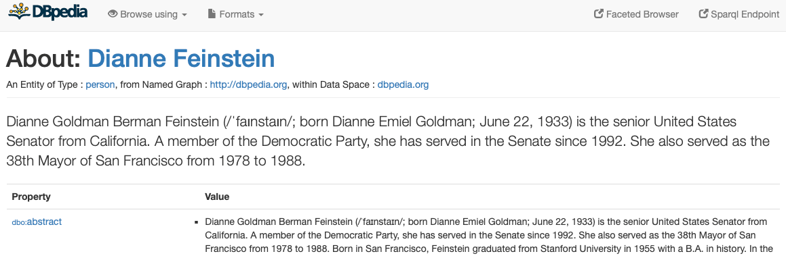
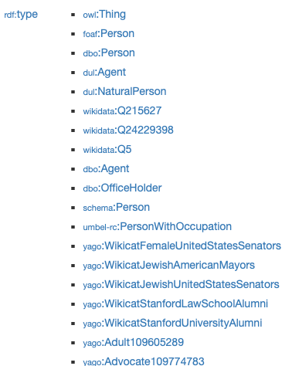
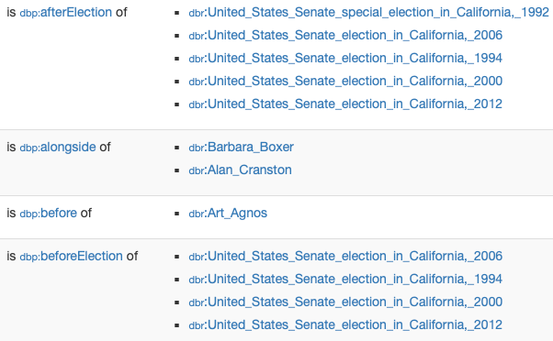
type
elections

Slide 52
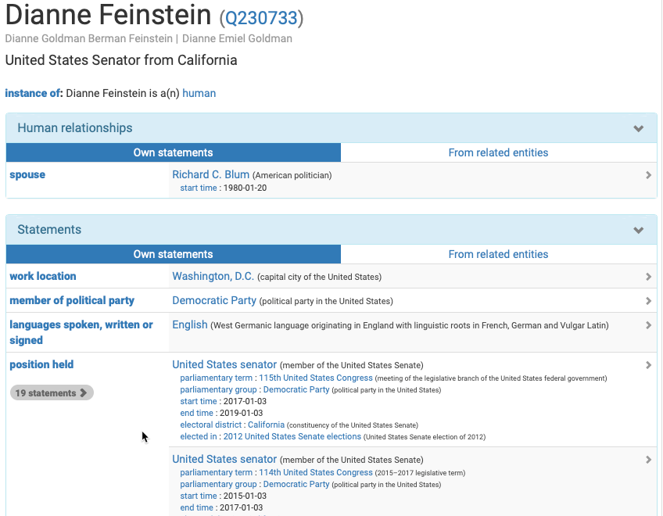
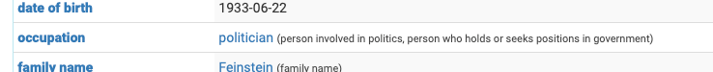
type
occupation
position held

Slide 53
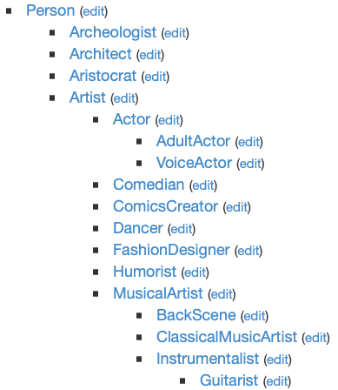
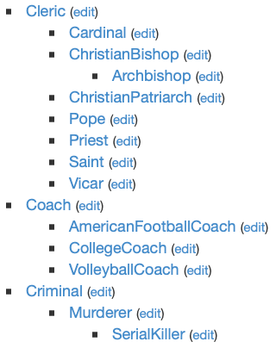
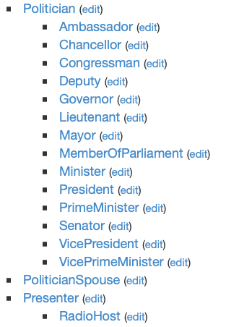
DBpedia Class Hierarchy (Person) http://mappings.dbpedia.org/server/ontology/classes/
position held
occupation

Slide 54
Wikidata Models Use Roles
type
Qualifiers used to provide context for the roles
occupation role
position held role

Slide 55
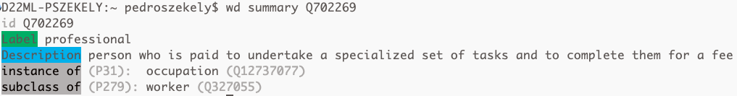
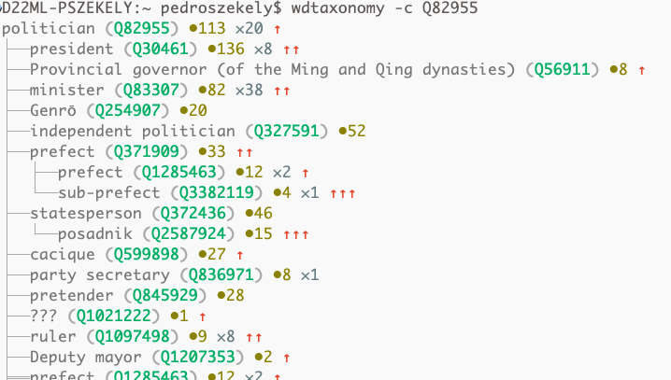
Wikidata Occupations Hierarchy
109,566 subclasses of professional (Q702269)
politician (Q82955) hierarchy (59,421 subclasses)

Slide 56
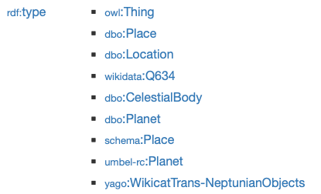
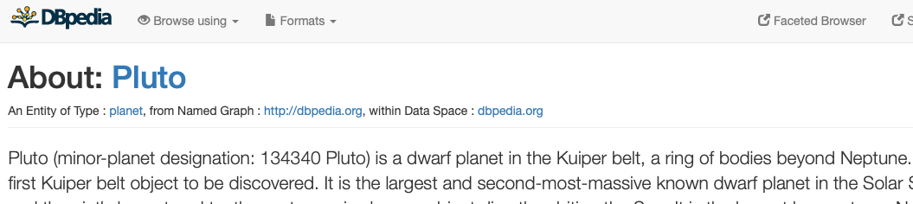
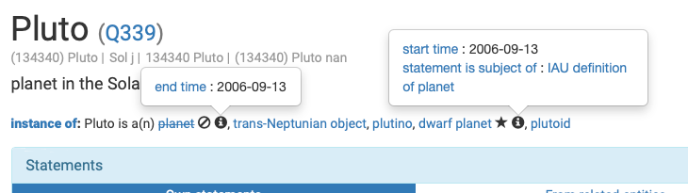
Pluto Is Instance Of ???
Dbpedia:
Pluto is a planet
Wikidata:
- Pluto was a planet until 2006-09-13
- Since 2006-09-13 it is a trans-Neptunian object
deprecated
preferred

Slide 57
RDF Data Model

Slide 58
Edges Are Statements (Reification)

Slide 59
Truthy Statements
All statements with rank = preferred
if there are any such statements
All statements with rank = normal
if there are no preferred statements
and there are statements with rank = normal
Statements with rank = deprecated are not truthy

Slide 60
RDF Model

Slide 61
RDF Model
P571
P571
P571
P571
P571
truthy values
P571
P571
P571
A property has different prefixes depending on where it is used

Slide 62
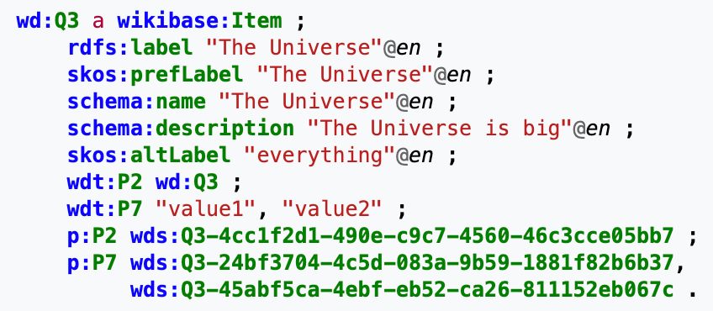
Wikidata RDF Format https://www.mediawiki.org/wiki/Wikibase/Indexing/RDF_Dump_Format
Item

Slide 63
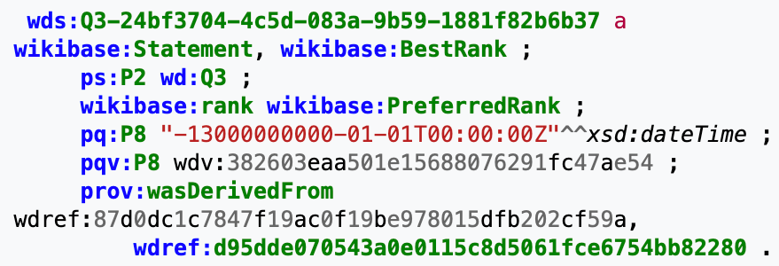
RDF Representation
Statement

Slide 64
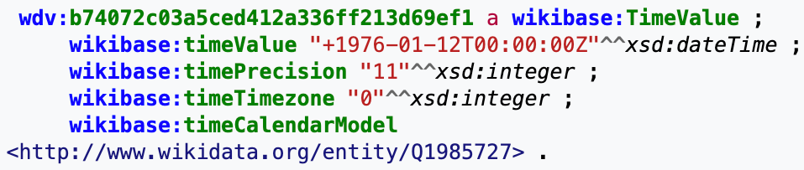
RDF Representation
Statement
Time Value

Slide 65
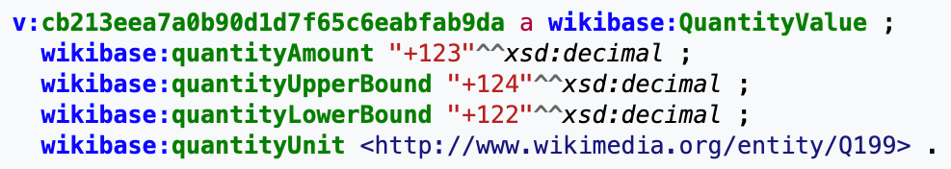
RDF Representation
Statement
Time Value
Quantity Value

Slide 66
Wikidata Statistics

Slide 67
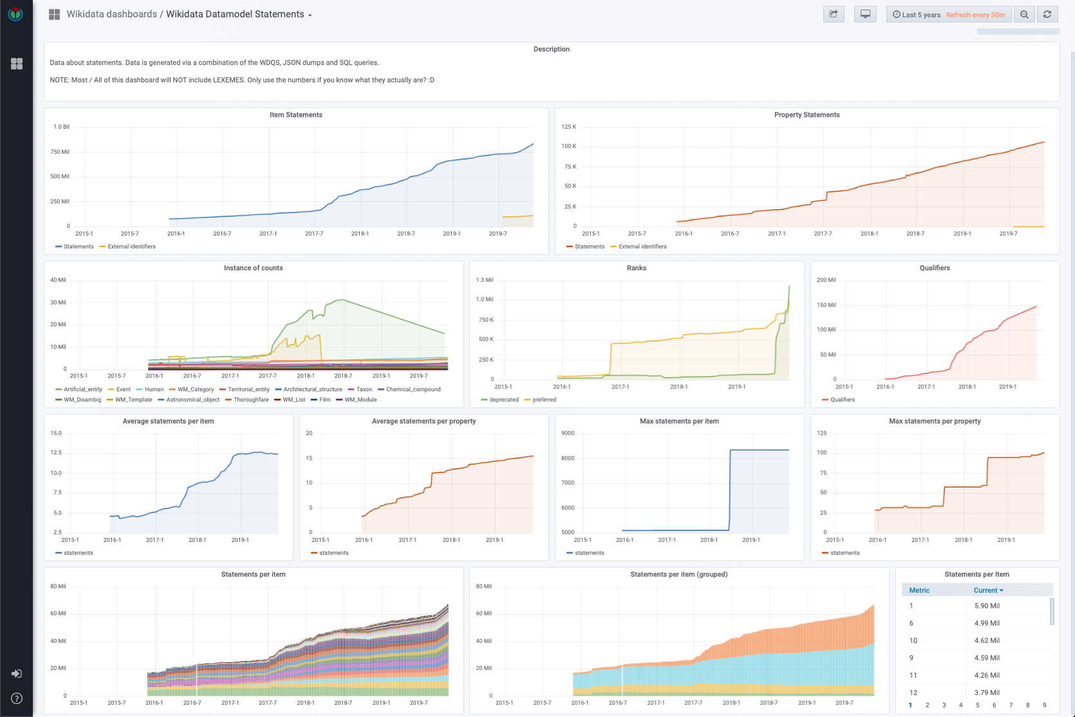
https://grafana.wikimedia.org/d/000000175/

Slide 68
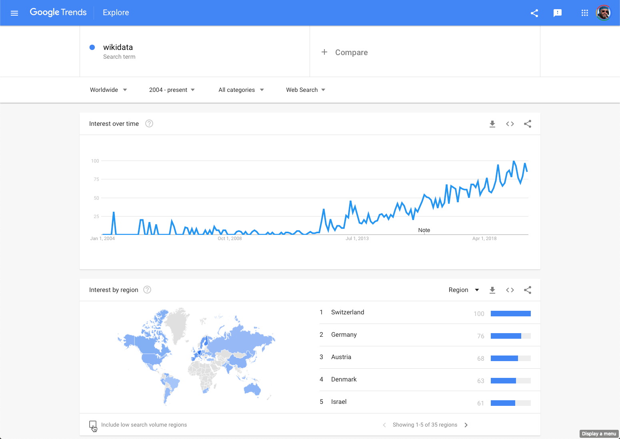
Google Trends

Slide 69
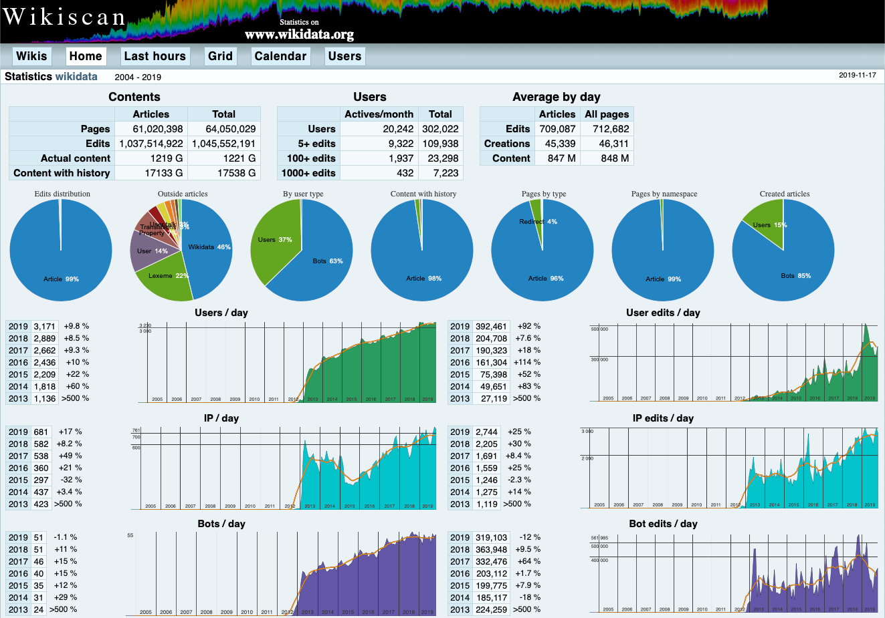
https://wikidata.wikiscan.org

Slide 70
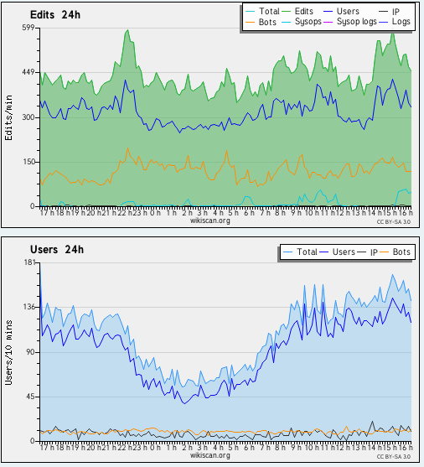
https://wikidata.wikiscan.org/hours
~10 edits/second

Slide 71
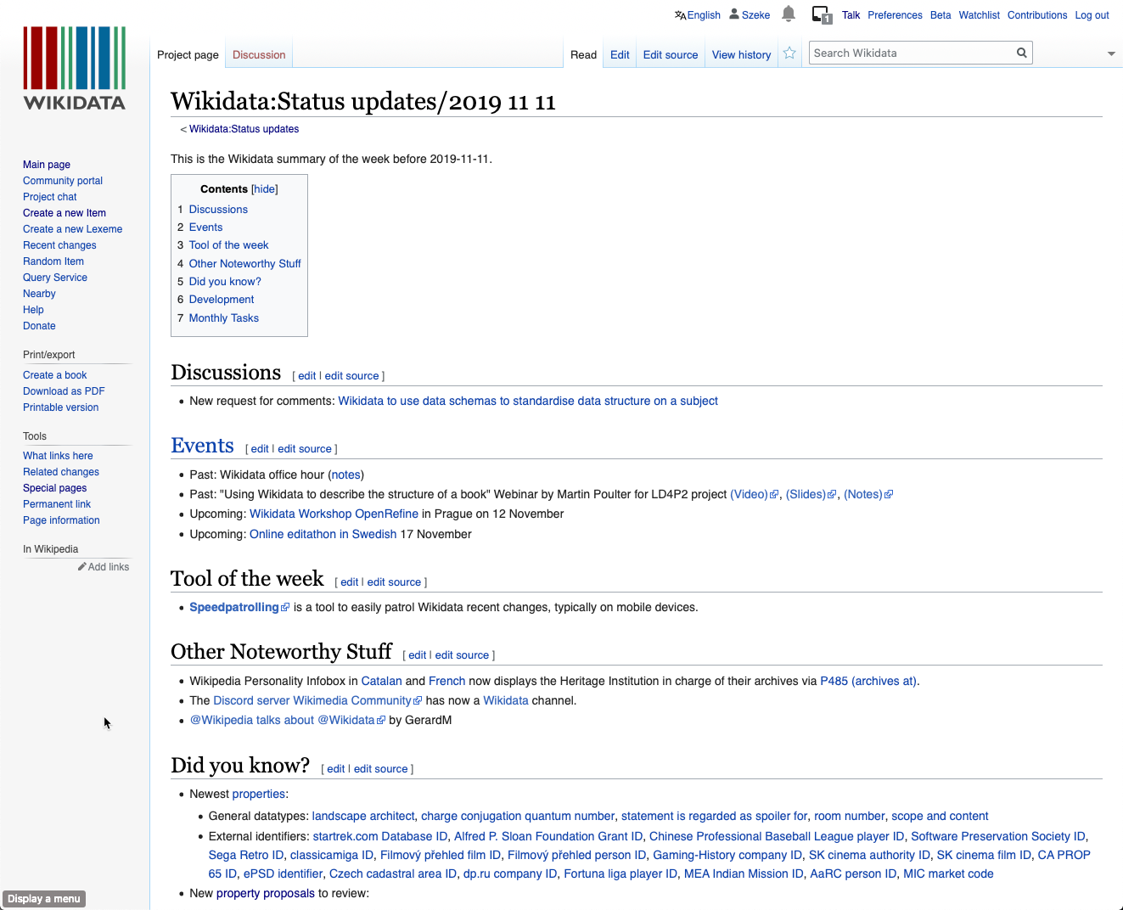
https://www.wikidata.org/wiki/Wikidata:Status_updates

Slide 72
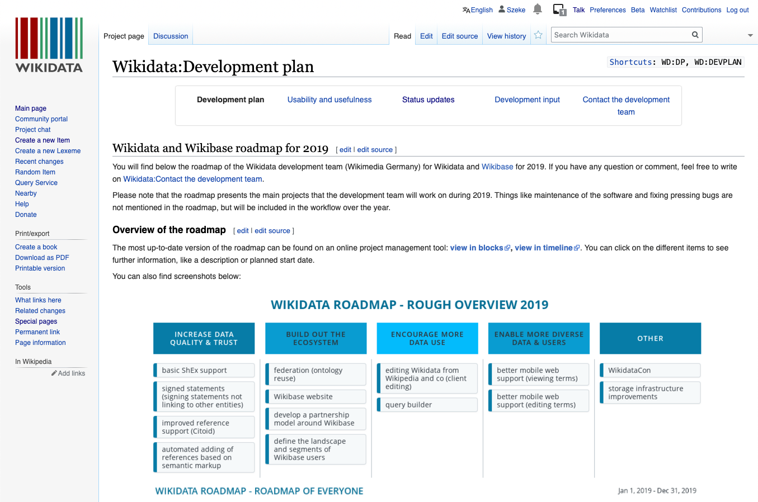
Keeping Up With New Developments https://www.wikidata.org/wiki/Wikidata:Development_plan

Slide 73
Wikidata Summary
Free
Collaborative
Multilingual
A secondary database
Collecting structured data
Support for Wikimedia wikis
Anyone in the world
> 60M items
> 6,000 properties
> 2,000,000 classes
> 4,000 external id types
Model using statements
Subject, property, value
Qualifiers, references

